Slide 1
Search Engine Marketing ─ Search Engine Optimization
Dr. Ruhai Wu

Slide 2
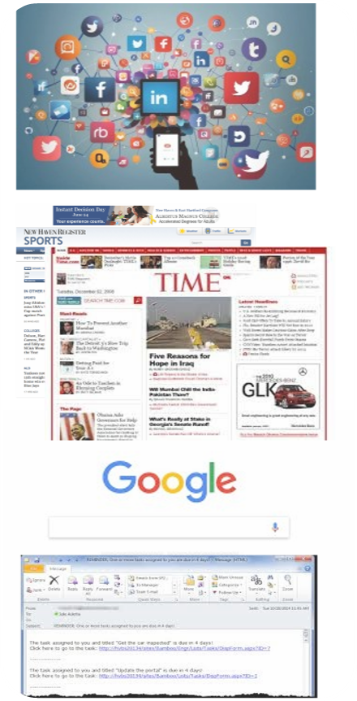
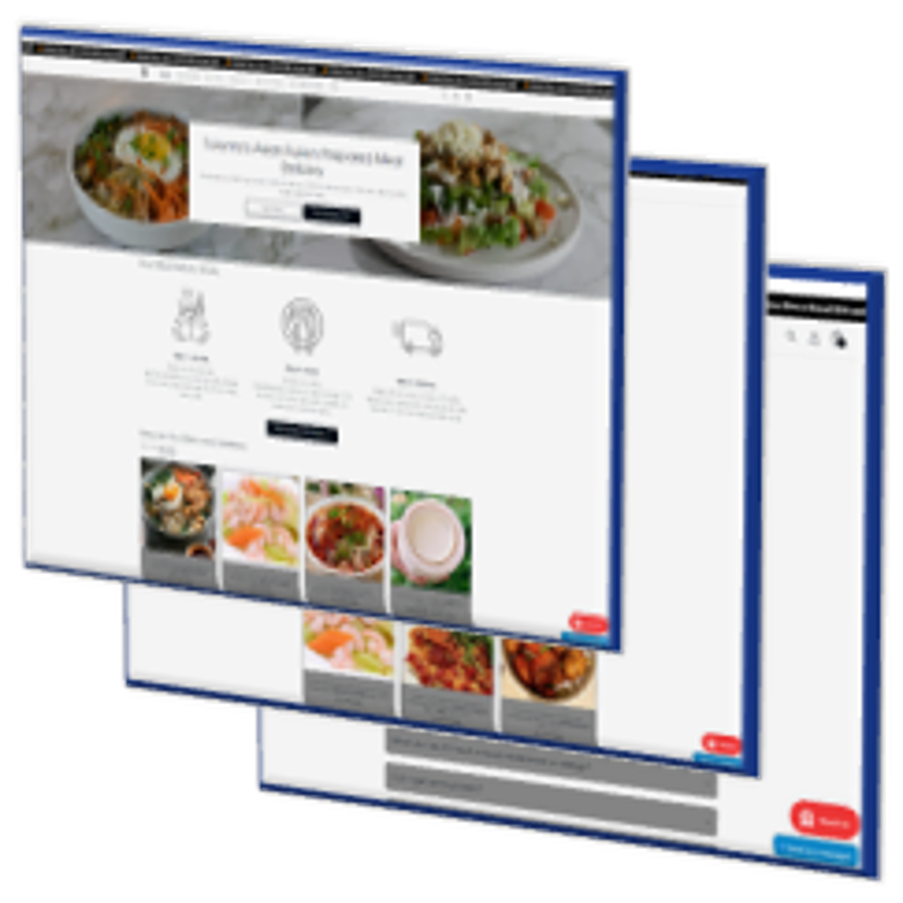
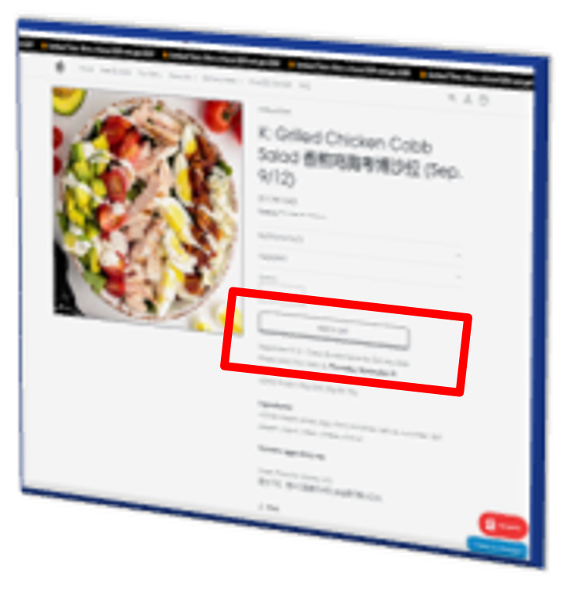
The Objective of Web Design
Digital Marketing Funnel
Website
Traffic
Conversion

Slide 3
The Objective of Web Design
Digital Marketing Funnel
Website
Traffic
Conversion
Organic Search
Paid Search
Search engine marketing (SEM) / Paid per click (PPC)
Search engine optimization (SEO)

Slide 4
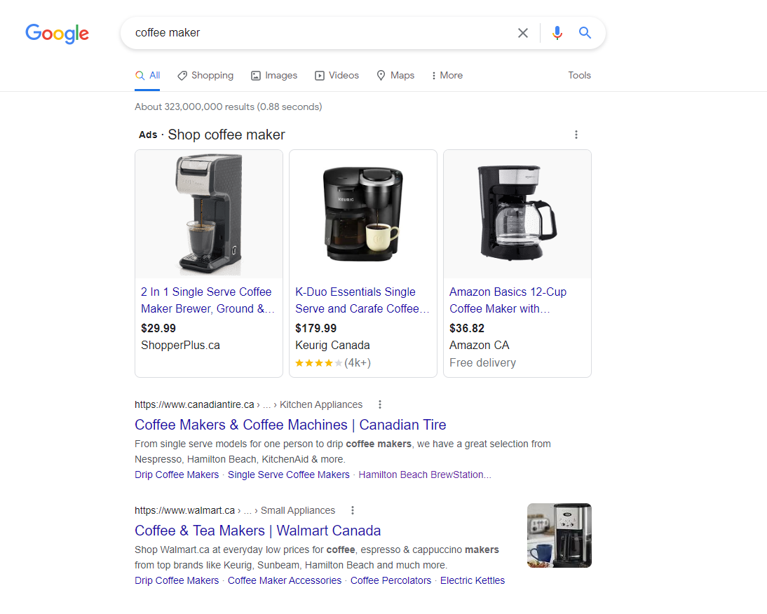
Search Engine Results Page (SERP)
Paid ads or sponsored links
Pay-per-Click (PPC) or Paid Search or Search Engine Marketing (SEM): to arrange ads targeted keyword searchers
Nature or Organic search results
Search Engine Optimization (SEO): The process of editing a web site’s content and code in order to improve visibility within one or more search engines

Slide 5
How does Google present a website?
URL to the landing page
Meta description
Page title of the landing page
Photo
Sitelinks
Notes:
Google examines a webpage and uses information on the page to automatically generate “page title”, “meta description”, “sitelinks”, and “photo”. Hence, we need to consider not only how to raise our visibility, but also how Google will introduce us in an SERP when designing a webpage.

Slide 6
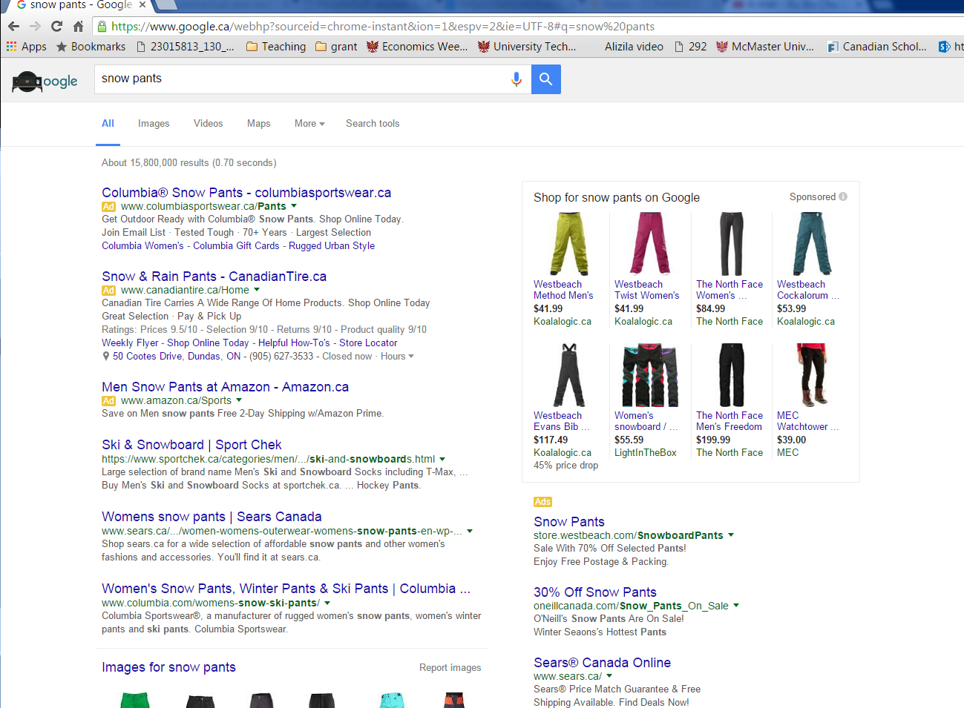

99 K search queries per second
8.5 B searches per day
3.1 T searches per year
40~90% of searches result in at least a click

Slide 7


Search for what?
83% for a specific product or brand
78% for more information after seeing an ad
80% for more information before purchase
78% for price information
Consumers with intentions
74% for location information
Notes:
Traffic from SEM has a higher conversion rate than those from refers and display ads.

Slide 8
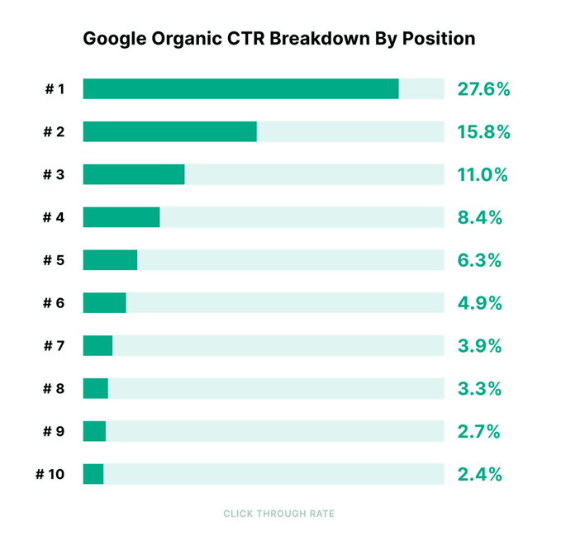
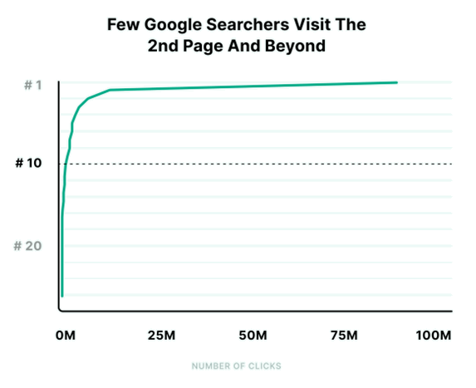
Two Key Factors of Online Search
1. Position / Ranking matters
SEO objective:
To rank higher in SERPs
Only 0.63% of Google searchers clicked from the second page

Slide 9
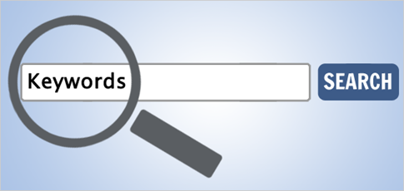
Two Key Factors of Online Search
SEO objective:
To rank higher in SERPs
2. Keywords matter
Different keywords generate different SERPs
A website’s ranking varies in these SERPs
People search the same item with different keywords
  Different interests
  Different knowledge/experience
  Different habits
  Different mood/attitude
Different keywords refer to different market segments

Slide 10
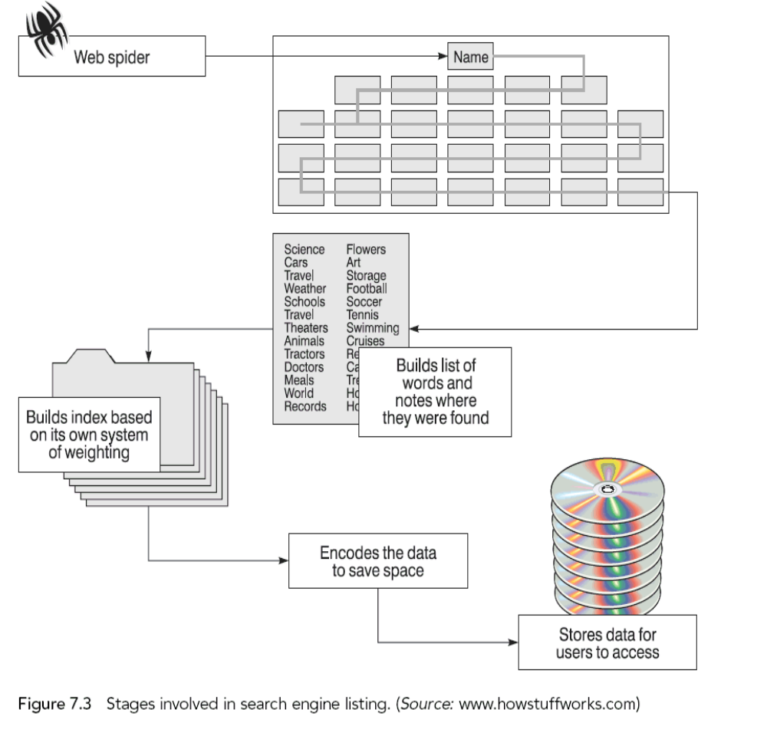
SEO―How does a search engine work?
Crawling
What does Google see on a website
Cached pages
Indexing
Query request
Score the page quality and relevance, storing the information into its database
Retrieve and rank relevant pages based on their score and index (search context also matters)
Notes:
Search engines compile an index by sending out spiders or robots to crawl around sites that are registered with the search engine. The spider compiles an index containing every word on every page against the page address. It weights the index according to different parameters and then stores the index as part of a database on a web server. This index is what is searched when potential customers type in key words. Google is rumored to use enormous factors within its search ranking algorithm and we will explore the most important ones of these in a moment.
Page quality includes content quality (reliable sources are prioritization) and webpage usability (appearance, devices, loading time etc.)
Relevance: how much relevant does Google evaluates the page content and the search keywords
Search context: location, past search history and search settings.

Slide 11


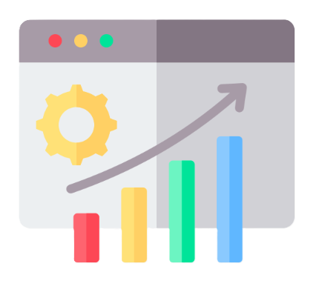
SEO ― Techniques
Register on the Search engine
Choose Keywords / Key Phrases
On Page Optimization
Improve Content Relevance to the Selected Key Phrase
Improve Page Quality
Enhance page Readability for search engines
Notes:
Three steps:
To inform Google of your website
To target on several keywords /key phrases
To optimize webpage design targeting the SERPs of the keywords

Slide 12
SEO ― Techniques
1. Register on the Search engine
Google Search Central
Google Search Console
[Beginner’s Guide]
Notes:
To help Google understand your website.
To provide a sitemap

Slide 13
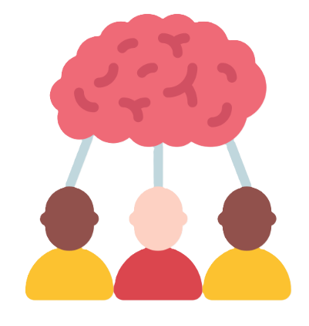



SEO ― Techniques
2. Choose Keywords / Key Phrases
Define a topic and brainstorm keywords
Target customer Keywords
Leverage competitors
Query Demand Tools
Focus on 1-5 keywords
Follow the phrases your target customers use for search
Analyze competitors' websites to refine your keyword strategy
Google Trends: public attentions
Google Ads Keyword Planner: precise prediction
Notes:
Example: TimSold
Define a topic
business relevant concepts/ knowledge (tech, market, product, even competitors, etc.)
who are the targeted customers? And what do they ask for? Steve’s Tea, Untangle Money
Query Demand: For public attentions (also as a powerful tool for market segmentation, targeting, and prediction)
Google Ads → Keywords Planner): For accurate
Google Trends: “blood pressure” or “hypertension”? “home renovation” or “home improvement”? “buy house” or “buy home” “sport shoes” or “sneakers” “coffee machine” or “coffee maker”
Automotive enthusiasts often refer to "aftermarket parts" for vehicle modifications, whereas the general public might use the term "custom parts.

Slide 14
SEO ― Techniques
3. On-page Optimization
• Emphasize in title tags
• Duplicate, but Word Count <20
• Avoid keyword stuffing
Keywords and Synonyms
Content Relevance
to the Selected Keywords
• Meta title
• Meta description
• Heading tags
• Other meta data
Meta data
Notes:
To let Google know what your page content is about (how does it interpret? Emphasize with special formats)
Keyword stuffing:
Popular practice
Normal duplication is needed to emphasize certain important topics
Could be punished by Google
May impede reading experience
To show meta data in the cached html file

Slide 15
SEO ― Techniques
3. On-page Optimization
• Conversion data
• Page loading Speed
• Mobile Friendly
• Too many ads? etc.
Page Experience
Page Quality recognized by the search engine
Experience, Expertise, Authoritativeness, Trustworthiness
• First-hand experience
• Official proof of license, etc.
• Inbound and Outbound links
• History of the webpage
• Content timeliness and update
E – E – A – T
Notes:
To let Google know what your page content is about (how does it interpret? Emphasize with special formats)
Keyword stuffing:
Popular practice
Normal duplication is needed to emphasize certain important topics
Could be punished by Google
May impede reading experience
To show meta data in the cached html file

Slide 16
SEO ― Techniques
3. On-page Optimization
Google Search works hard to understand the content of a page. You can help us by providing explicit clues about the meaning of a page to Google by including structured data on the page.
Structured data is a standardized format for providing information about a page and classifying the page content; for example, on a recipe page, what are the ingredients, the cooking time and temperature, the calories, and so on. Google uses structured data that it finds on the web to understand the content of the page, as well as to gather information about the web and the world in general. Structured data is a system of pairing a name with a value that helps search engines categorize and index your content. Microdata is one form of structured data that works with HTML5.
Schema.org is a project that provides a particular set of agreed-upon definitions for microdata tags.
More information at https://developers.google.com/search/docs/guides/intro-structured-data
Structured Data
Page Readability
for the search engine
Microdata
Schema
Notes:
To let Google know what your page content is about (how does it interpret? Emphasize with special formats)
To show meta data in the cached html file

Slide 17
How does Google present a website?
URL to the landing page
Meta description
Page title of the landing page
Photo
Sitelinks

Slide 18
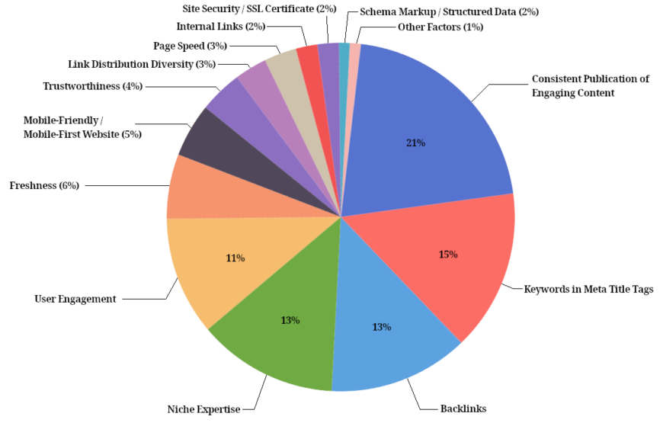
SEO ― Techniques
Trends
  Localization
  Mobile
  Context
Learning References
  Google guide for SEO
  Moz learning center
  Local SEO Research
Tools
  SEO Site Checkup (evaluation report of the SEO performance of your website)
  Broseo (See your site through the eyes of a search engine)
  Ahrefs, SimilarWeb, SEOptimer, AnswerThePublic

